Slide 1

CBA Bench and Bar Liaison Committee
Federal Court Update
Chief Justice Paul Crampton
October 16, 2020

Slide 2

Overview
1. COVID-19 Practice Directions and Orders
2. The Transition to virtual hearings
3. In-person hearings
4. Looking ahead
5. 2020-2025 Strategic Plan
6. Changes in judicial complement
2

Slide 3
1. COVID-19 Practice Directions and Orders
3

Slide 4
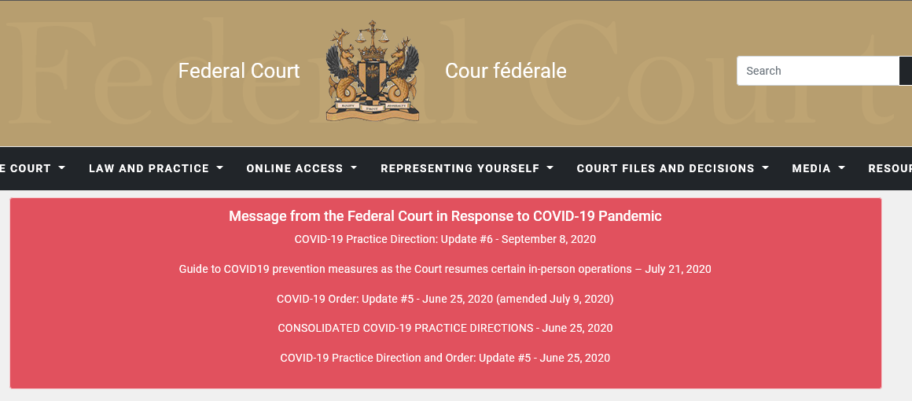
4

Slide 5
COVID-19: Initial Communication (March 13th)
Announced interim measures to balance two paramount priorities:
  The health and safety of parties to proceedings before the Court, their counsel, the general public, employees and members of the Court; and
  Remaining accessible to Canadians who may wish to move forward with the resolution of their legal disputes
The optimal balancing of these two priorities continues to guide the Court’s approach
5

Slide 6
COVID-19 : March 17th – September 8th updates
Bench & Bar Committee provided valuable input into each of the updated practice directions and orders
  Timely turnaround was particularly helpful
Several extensions to the Suspension Period until reopening of facilities in July
Various administrative practices were adopted to facilitate moving forward with hearings, procedural steps, etc.
6

Slide 7
COVID-19: Administrative practices continue (1)
Despite the termination of the Suspension Period, most of the administrative practices set forth in the various prior COVID-19 PDs remain in force:
  September 8th PD, ¶ 6 – referencing various paragraphs of June 25th Consolidated PD):
    JRs and general sittings to be heard virtually – but Court will consider requests for an in-person hearing, for these and other matters
    Parties encouraged to move forward electronically and file docs via e-filing portal
      Select local office in the drop-down menu
      Confidential docs to be sent to the Court’s CMT e-mail address – password protection or secure electronic file transfer
7

Slide 8
COVID-19: Administrative practices continue (2)
    Proceedings in case management still subject to discretion of CM judge
    Virtual hearings to be conducted over Zoom
    Court will need electronic copies of documents required for the hearing
    Exemption from requirement to file paper copies
    Page numbering and pinpoint references required
    Suspension of requirement to gown
8

Slide 9
COVID-19: Administrative practices continue (3)
  Deemed consent to electronic service for parties who have provided an electronic e-mail address on a filed document (Rules 141 & 148)
  Registry will effect personal service of certain IMM originating documents
  Media and general public may request electronic copies of public documents
  Media and general public may “attend” virtual hearings - 2 business days’ notice
  Remote commissioning of affidavits – will be accepted if in accordance with requirements of provincial superior court (But must be sworn or affirmed)
    Requirement to file printed version was vacated by July 9th COVID-19 Order (Update #5)
9

Slide 10
COVID-19 PDs and Bill C-20
The September 8th PD (update #6) states:
  “Notwithstanding the enactment of the Act, this Court’s COVID-19 practice directions, as well as its intervening judgments, orders and directions, remain in full force and effect: see Reference re Section 6 of Time Limits and Other Periods Act (COVID-19), 2020 FCA 137. This includes as they relate to the time limits set out in the Designated Federal Statutes.”
10

Slide 11
2. The Transition To Virtual Hearings
11

Slide 12
The Transition
The Court began conducting virtual hearings over Zoom in April
We then announced that virtual hearings would be held over Zoom “for the time being” (April 29th Practice Direction – Update #2)
Extensive internal and external training sessions and materials were prepared in April/May
12

Slide 13

13

Slide 14
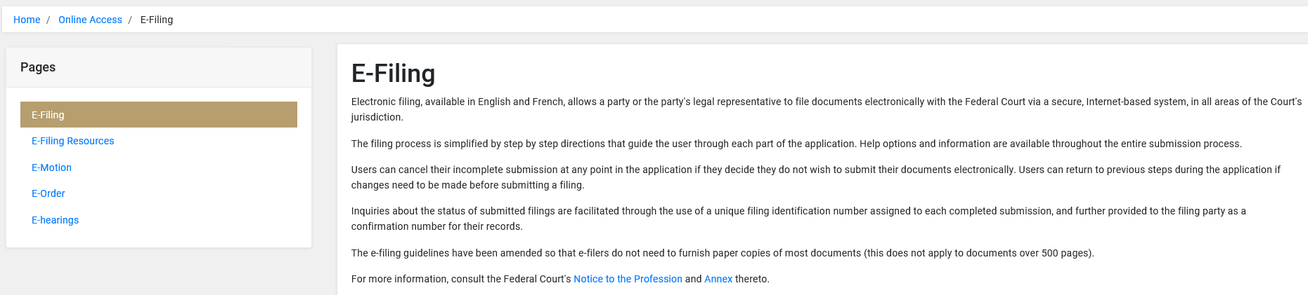
14

Slide 15
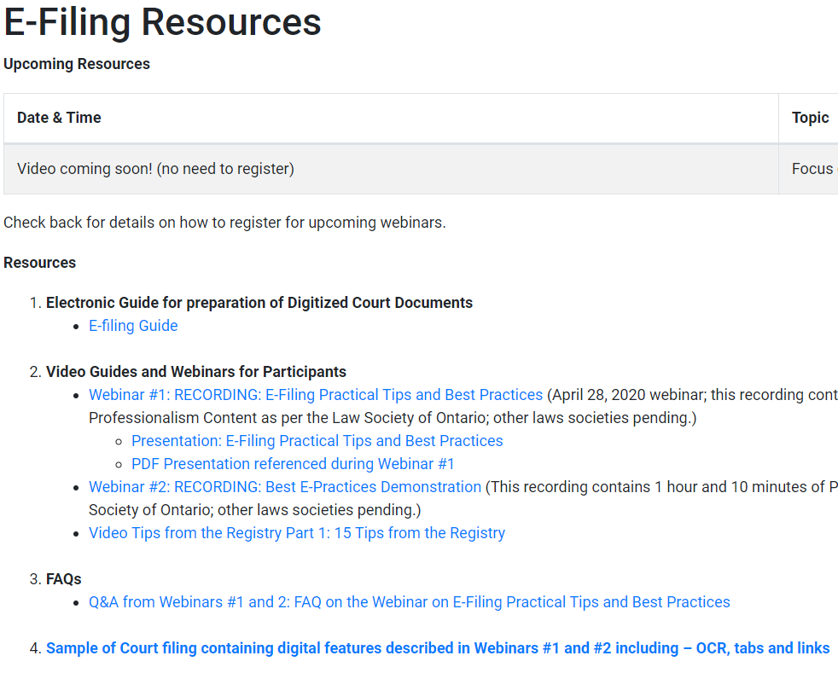
15

Slide 16
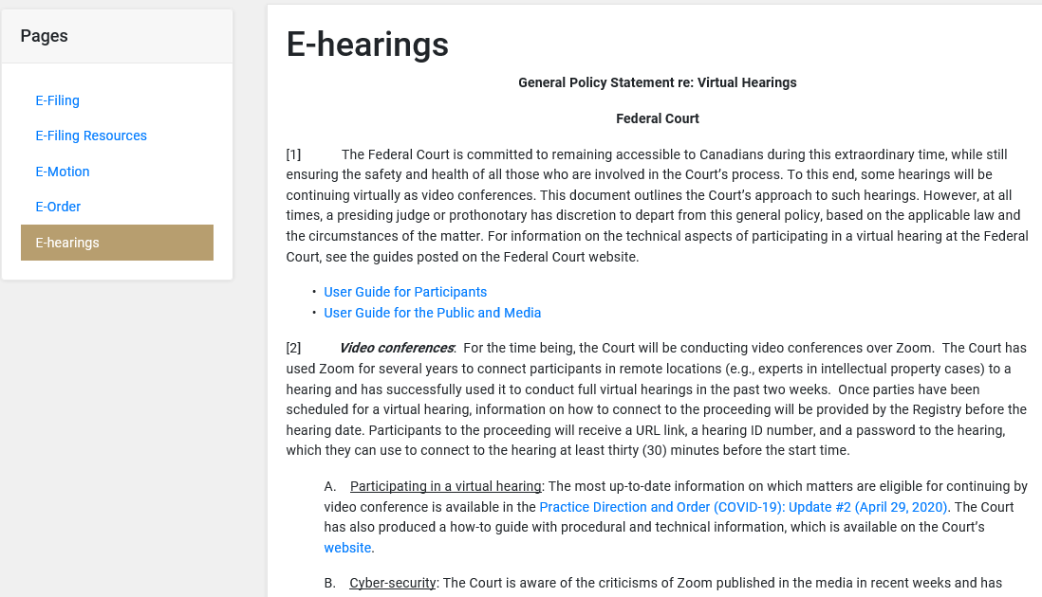
16

Slide 17
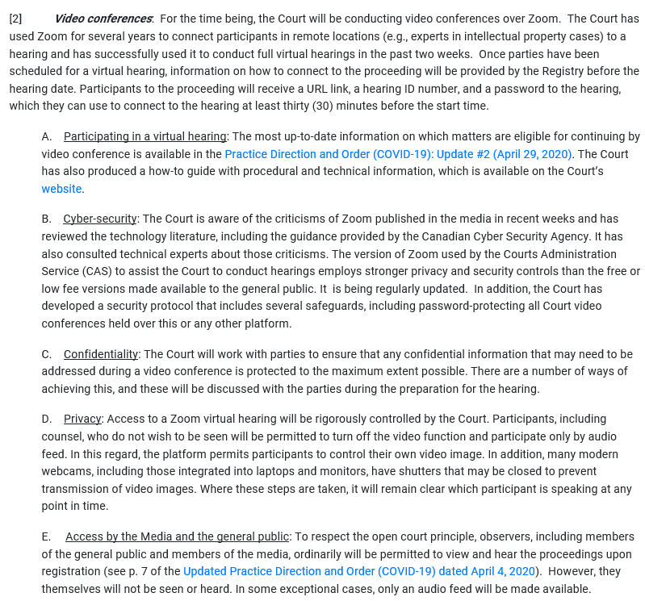
17

Slide 18
Practical Challenges (1)
(most stakeholders)
Working from home:
  Young children
  Inadequate or no workspace
  Insufficient or no equipment
  Software licences
18

Slide 19
Practical Challenges (2)
Restricted or no access to physical documents/files
Legal aid funding for scanning
Difficulties obtaining CTRs
Logistical/procedural difficulties with web-based sharing platforms
Restricted ability to download/print documents
Asymmetric economic pressures across constituencies
19

Slide 20
Additional Challenges
Cyber-security, including “Zoom bombing”
Confidentiality
Privacy
Access by the media and general public
Strategic delay
20

Slide 21
Virtual hearings
Virtual hearings have become “the new normal”
  Over 400 virtual hearings have been held (including motions, case management conferences, trial management conferences and pre-trial conferences)
  Substantial demand for virtual hearings expected to continue post-COVID-19
Technical & logistical issues are diminishing, but still occurring
Feedback welcomed!
21

Slide 22
Making it happen
An additional 750+ teleconference hearings have been held (mostly CMCs and TMCs, but also approximately 60 JRs/motions)
Backlog of adjourned hearings has largely been eliminated
Of approx. 630 matters that were adjourned, less than 50 remain to be rescheduled (4 trials, 39 JRs and 6 motions)
22

Slide 23
3. In-person Hearings
23

Slide 24
In-person hearings - availability
Subject to measures announced by local health authorities, requests can continue to be made for an in-person hearing. The court will consider all of the circumstances, including:
  Views of other party
  Availability of local staff
Despite availability of this mode of hearing, there is little demand
24

Slide 25
In-person hearings - safeguards
CAS’s COVID-19: Recommended Preventative Measures
  Covers from the front door of our facility to the courtroom door
The Court’s Guide for In-person Hearings
  Addressed to safeguards within the courtroom
    Masks must be worn, subject to limited exceptions
    Plexiglass dividers when two meter rule can’t be met
    Assigned seating for public and media
    Court attendees encouraged to bring own water bottles
    Procedures for transmission of documents
    Contact numbers for contact tracing
25

Slide 26
4. Looking Ahead
26

Slide 27
Looking ahead (1)
The Court’s workload is continuing to ramp back up
Huge volume of immigration decisions anticipated in coming months/year
Additional files currently stuck in system due to unavailability of Certified Tribunal Records in electronic format
27

Slide 28

Approx. 400 IMM Requests for Leave currently in limbo:
RPD - 123
ID – 120
IAD – 15
PRRA – 117
Outside Canada - 138
28

Slide 29
Looking ahead (2) - IMM Forecast:
IRB Totals for FY 2019-2020
RPD: 40K
RAD: 10K
IAD: 2.4K
ID: 8K (detention) + 900 (admissibility)
29

Slide 30
Looking Ahead (3): IMM RAD
RAD pilot project: 65 dates given so far, plus 35 awaiting a hearing date pending receipt of CTRs (Production Orders issued)
More broadly, RAD has issued approx. 2000 decisions in the last 16 weeks
Projecting min. 200 weekly for coming weeks
In 2019, 26% of negative RAD decisions (1521) were JR’d
    This suggests that approx. 450 files may be working their way towards us, with at least another 52 per week after that
30

Slide 31
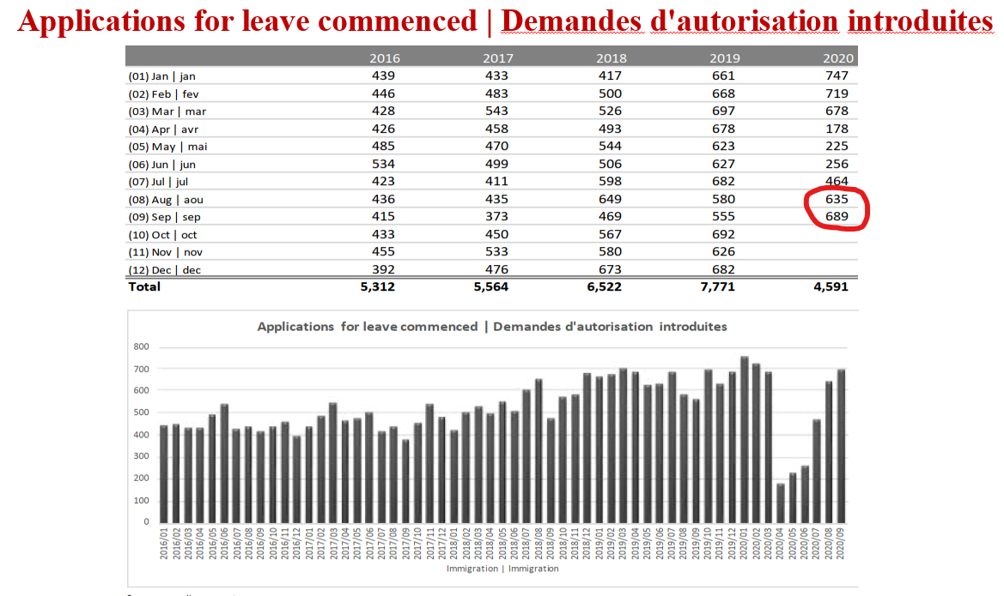
31
Notes:
Source: proceeding_segments

Slide 32
Looking Ahead (4)
Travel/safety restrictions will continue to present challenges
  In-person hearings
  Witnesses
Funding to assist the entire “eco-system” to transition to a much more digital system will be critical
32

Slide 33
Looking Ahead (5)
Some counsel are clearly missing the in-person setting
  Cross-examination
  Cues from judge
  Non-verbal language
  Opportunities to communicate with co-counsel and opposing counsel
33

Slide 34
Current schedule:
(oct – dec 2020)
287 hearings:
67 JR IMM
58 JR T
41 motions
28 trials
34

Slide 35
Current schedule:
(oct - dec 2020)
43 in-person hearings:
20 in October
15 in November
8 in December
(NB: Only 10 in September)
35

Slide 36
Non-IMM Forecast
Difficult to predict evolution of future workload
But we assume a return to “normal” volumes post-COVID-19
36

Slide 37
5. 2020-2025 Strategic Plan
37
Notes:
.

Slide 38
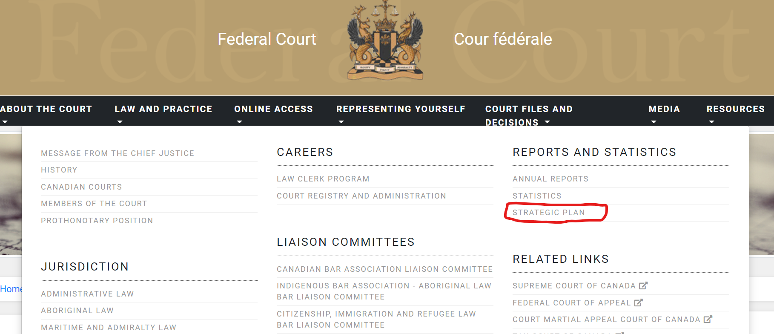
38

Slide 39
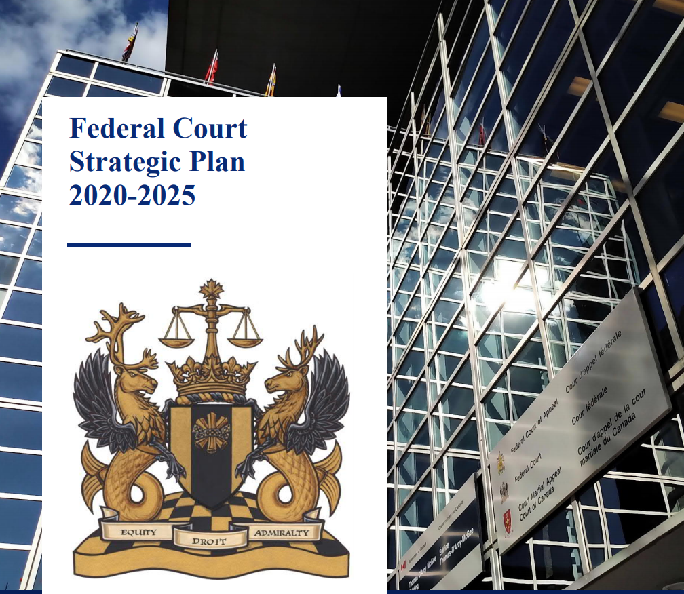
39

Slide 40
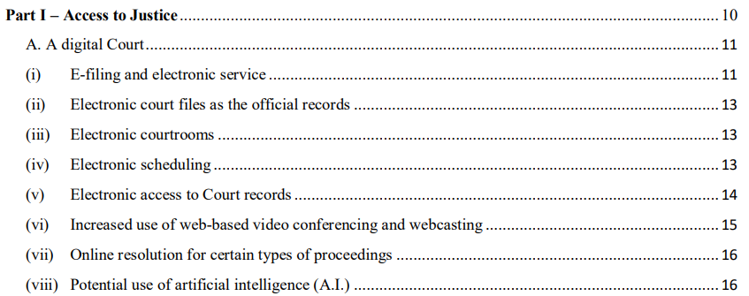
2020-2025 Strategic Plan
40

Slide 41
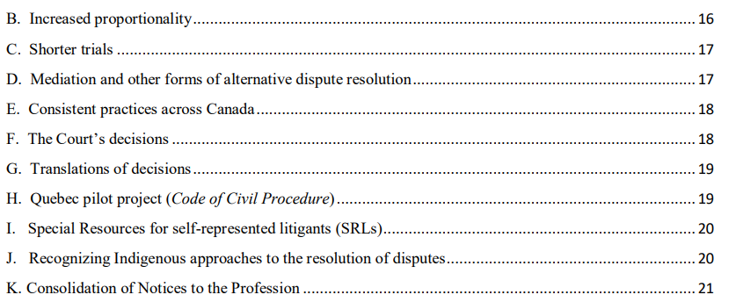
41

Slide 42
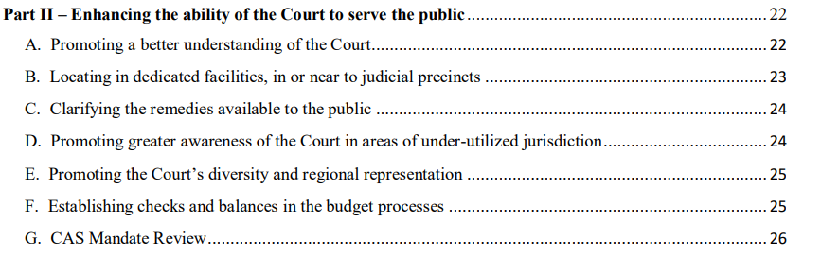
42

Slide 43
5. Changes in judicial complement
43

Slide 44
  2020 appointments/departures
  Appointments:
    Justice Christine Pallotta (02/02/20)
    Justice Andrew Little (30/04/20)
  Departures :
    Justice Douglas Campbell (retirement 27/08/20)
    Justice James Russell (retirement 31/08/20)
    Justice René Leblanc (appointed to FCA 30/04/20)
44

Slide 45
    Vacancies
    3 in Quebec
    1 in Ontario
    2 positions created in Budget 2019 and 1 created in Budget 2018 will only be filled when the Court can demonstrate need
45

Slide 46
Thank You
46

